Slide 1
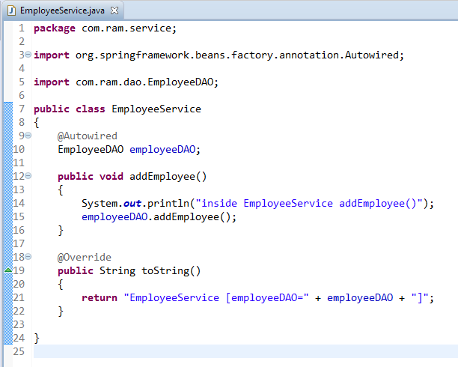
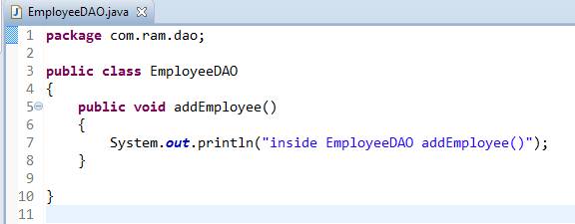
Spring Filter components in auto scanning

Slide 2
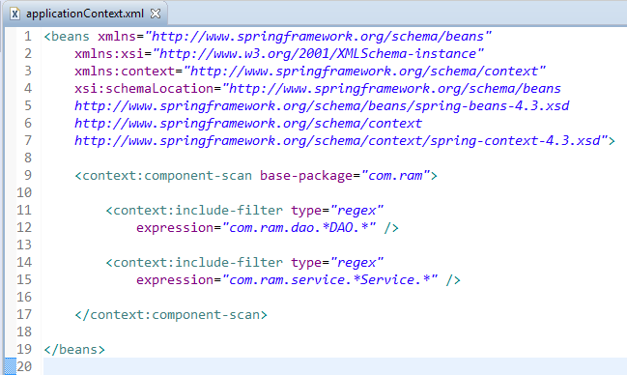
Spring Filter components in auto scanning
Filter component – include
Spring “filtering” to scan and register components’ name which matched defined “regex”, even the class is not annotated with @Component.
In this XML filtering, all files’s name contains DAO or Service (*DAO.*, *Services.*) word will be detect and register in Spring container.

Slide 3
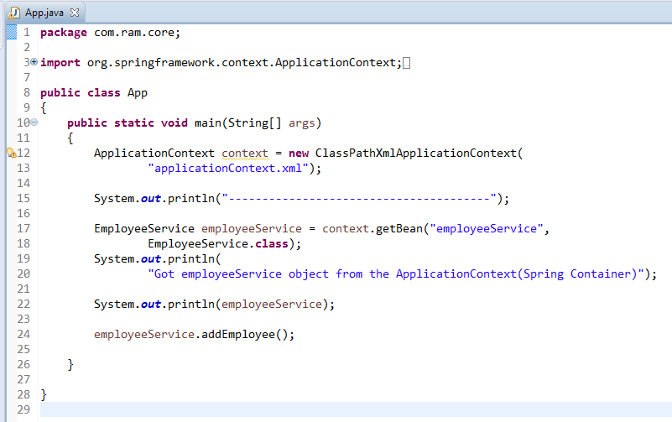
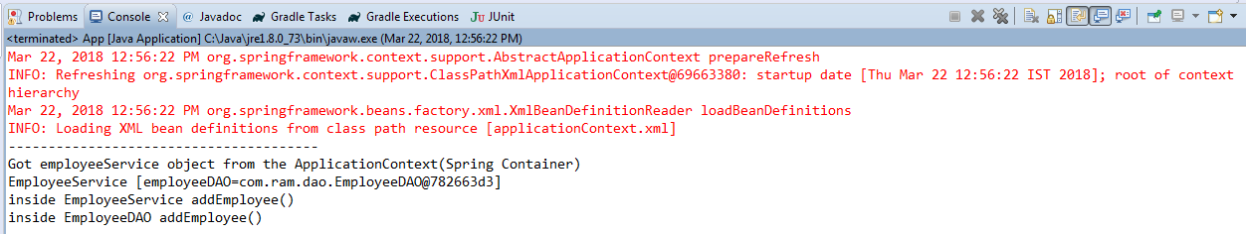
Spring Filter components in auto scanning

Slide 4
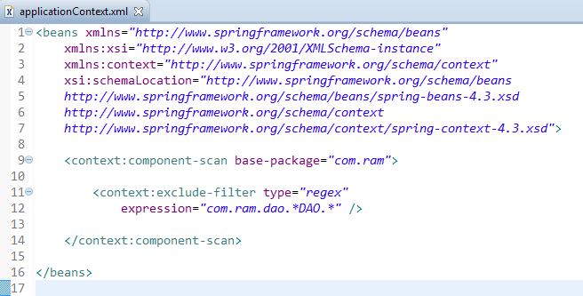
Spring Filter components in auto scanning
Filter component – exclude
We can also exclude specified components, to avoid Spring to detect and register it in Spring container.
Exclude the files name contains DAO word.

